Slide 1
ANTERIOR CERVICAL DISCECTOMY AND FUSION FOR TREATING CERVICAL DISC HERNIATION
THAI NGUYEN UNIVERSITY OF MEDICINE AND PHARMACY

Slide 2
01 OVERVIEW
Notes:
Cervical disc herniation is a common cause of neck pain in adults. The severity of the disease can range from mild to severe, and even life-threatening

Slide 3
DEFINITION
A cervical herniated disc occurs when the inner portion of a disc in the cervical spine—or neck—ruptures through the outer wall of the disc.
When a cervical disc herniates, it can impinge on or cause inflammation near one of these cervical nerves, causing pain and other symptoms to radiate along the path of the nerve
Treatment for a cervical herniated disc may include nonsurgical options to manage the symptoms, or surgery to remove the herniated portion of the disc.

Slide 4
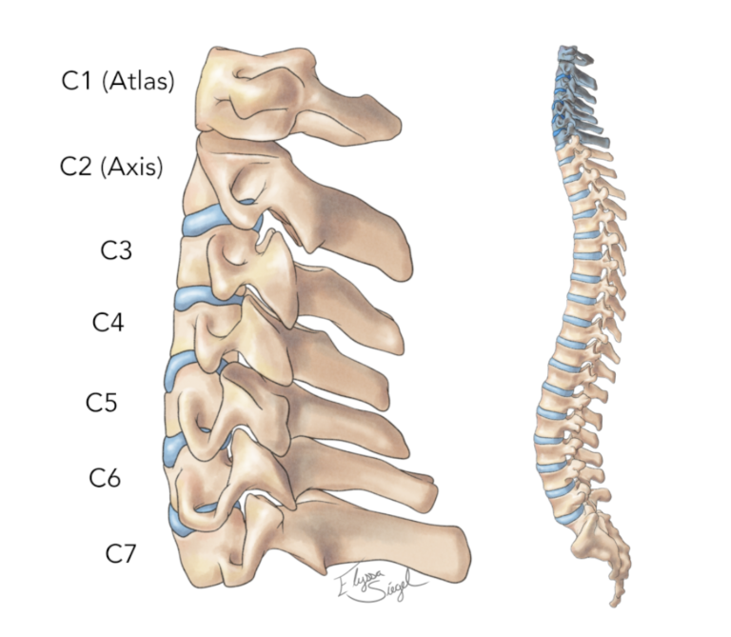
CERVICAL SPINE ANATOMY
The cervical spine has 7 stacked bones called vertebrae, labeled C1 through C7. The top of the cervical spine connects to the skull, and the bottom connects to the upper back at about shoulder level

Slide 5
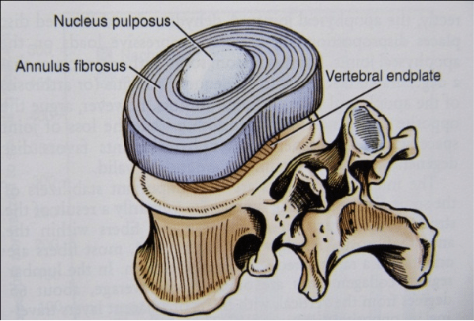
CERVICAL DISC ANATOMY
Each cervical disc has 2 basic components:
Outer layer. This tough exterior, called the annulus fibrosus, is comprised of collagen fibers that surround and protect the inner core.
Inner core. This soft jelly interior, called the nucleus pulposus, is a loose, fibrous network suspended in mucoprotein gel that is sealed by the annulus fibrosus.

Slide 6
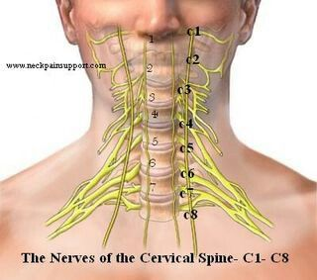
CERVICAL NERVE ANATOMY
here are 8 pairs of spinal nerves in the cervical spine, labeled C1 to C8.
Each spinal nerve is supplied by 2 nerve roots. The anterior root, located in front, carries motor signals from the brain out to the body. The posterior root, located in back, carries sensory signals from the body back to the brain.

Slide 7
DIAGNOSIS
The following may be used to diagnose a cervical disc herniation:
Medical history, including symptoms and past neck injuries or surgeries.
Physical examination to identify which nerve(s) might be compressed.
Blood tests to look for inflammation, tumor, or other conditions that might be causing the symptoms.
Imaging tests to look for a herniated disc or damage to the vertebrae or other tissues of the spine. This may include X-rays, CT scan, or an MRI.

Slide 8
DIAGNOSIS
Physical examination: solitary nerve lesions due to compression by a herniated disc in the cervical spine - C2 Nerve – eye or ear pain, headache.
C3, C4 Nerve – vague neck, trapezial tenderness, and muscle spasms.
C5 Nerve – neck, shoulder, and scapula pain. Lateral arm paresthesia. Primary motions affected include shoulder abduction and elbow flexion
C6 Nerve – neck, shoulder, and scapula pain. Paresthesia of the lateral forearm, lateral hand, and lateral two digits. Primary motions affected include elbow flexion and wrist extension
C7 Nerve – neck and shoulder pain. Paresthesia of the posterior forearm and third digit. Primary motions affected include elbow extension and wrist flexion
C8 Nerve – neck and shoulder pain. Paresthesia of the medial forearm, medial hand, and medial two digits. Weakness during finger flexion, handgrip, and thumb extension.

Slide 9
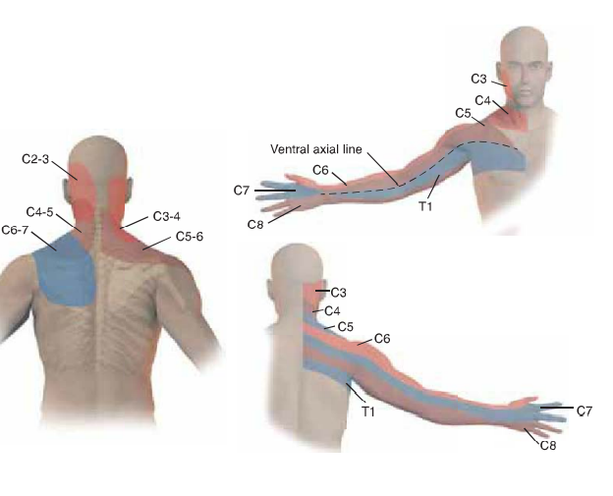

Slide 10
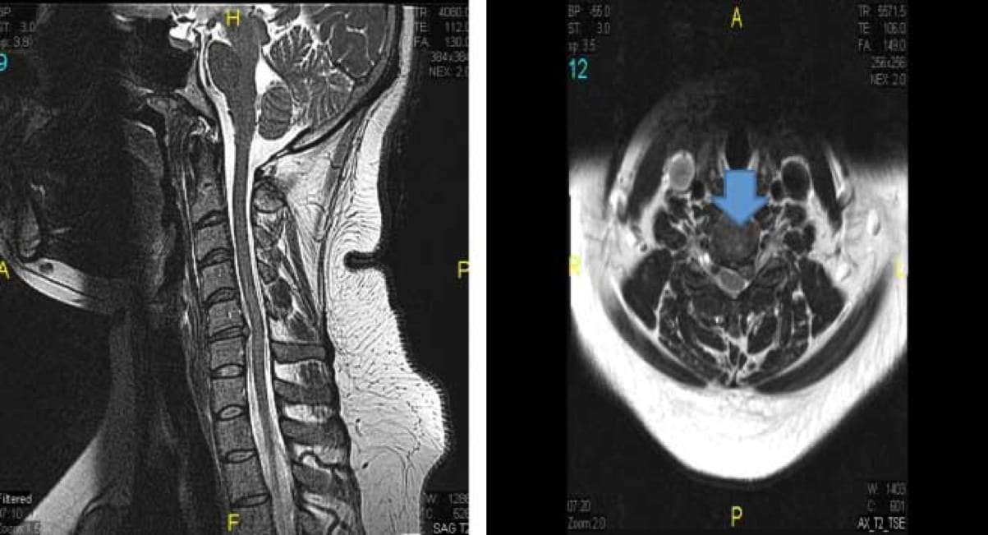
DIAGNOSIS
paraclinical
MRI: The preferred imaging modality and the most sensitive study to visualize a herniated disc

Slide 11
DIFFERENTIAL DIAGNOSIS
Differential diagnoses include:
Brachial plexus injury
Degenerative cervical spondylosis
Muscle strain
Peripheral nerve entrapment
Tendinopathy of the shoulder

Slide 12
02 Surgical

Slide 13
SURGICAL OPTIONS
anterior cervical discectomy ( ACD)
Anterior cervical discectomy with fusion (ACDF)
Anterior Cervical disc arthroplasty (ACDA)
Posterior cervical decompression
Cervical keyhole laminectomy

Slide 14
INDICATION ACDF
Persistent or recurrent arm pain/numbness that is unresponsive to a trial of conservative treatment
Neurologic deficit
Confirmatory axial imaging studies consistent with the patient’s clinical

Slide 15
CONTRAINDICATION
No absolute contraindications :
Prior neck irradiation
Prior anterior neck surgery
Tracheostomy
Primary posterior pathology (hypertrophied ligamentum flavum)
Ossification of the posterior longitudinal ligament
Severe osteoporosis
Notes:
Contraindications 

Slide 16
MAIN STEPS OF ACDF
Step 2:
Locating the Damaged Disc
Step 3:
Removing the Damaged Disc and decompressing the Nerve
Step 1:
Incision and Exposure
Step 4:
cervical fusion

Slide 17
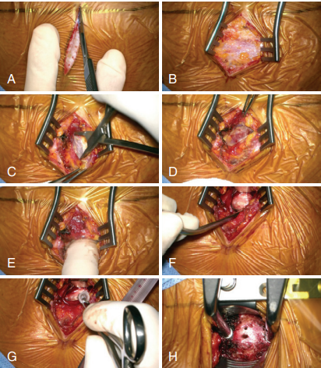
MAIN STEPS OF ACDF
Step 1:Incision and Exposure
- we first start with a small transverse incision on the side of the neck and we dissect directly into the anterior part of the neck

Slide 18
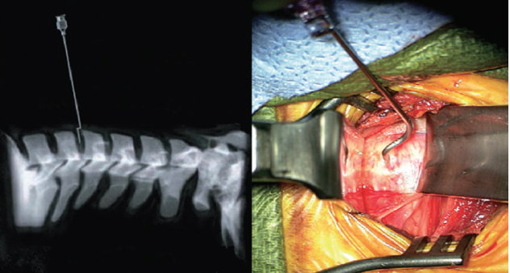
MAIN STEPS OF ACDF
Step 2:Locating the Damaged Disc
- Confirms that the correct disc has been located by inserting a needle into the disc space under X-ray guidance.

Slide 19
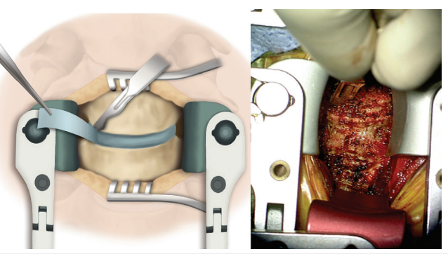
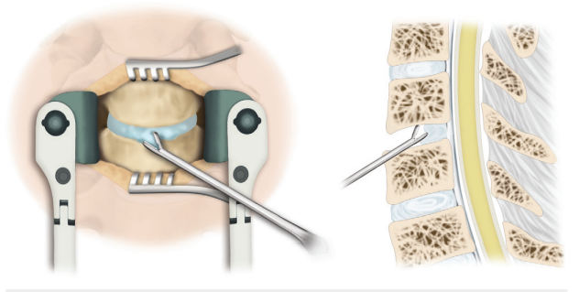
MAIN STEPS OF ACDF
Step 3: Removing the Damaged Disc and decompressing the Nerve

Slide 20
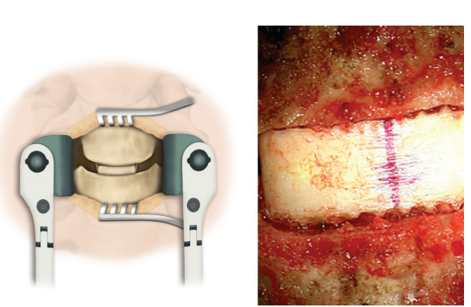
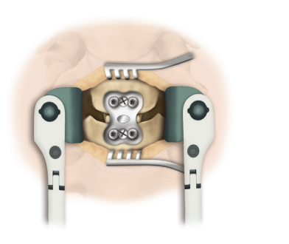
MAIN STEPS OF ACDF
Step 4: Cervical fusion

Slide 21
COMPLICATIONS
Hemorrhage or formation of a wound hematoma
Damage to the carotid or vertebral artery
Damage to the recurrent laryngeal nerve
Damage to the superior laryngeal nerve
Damage to the esophagus or trachea
Damage to the dura, resulting in a cerebrospinal fluid leak or pocket of cerebral spinal fluid beneath the incision (pseudomeningocele)
Mechanical complications of the graft and plate (including graft migration, breakage of the plate, screw pullout, etc.)
Wound infection
Development of painful pseudoarthrosis
Damage to the spinal cord or nerve root(s) resulting in pain, weakness, paralysis, loss of sensation, loss of bowel or bladder function, impaired sexual function, etc

Slide 22
03 RESULTS

Slide 23
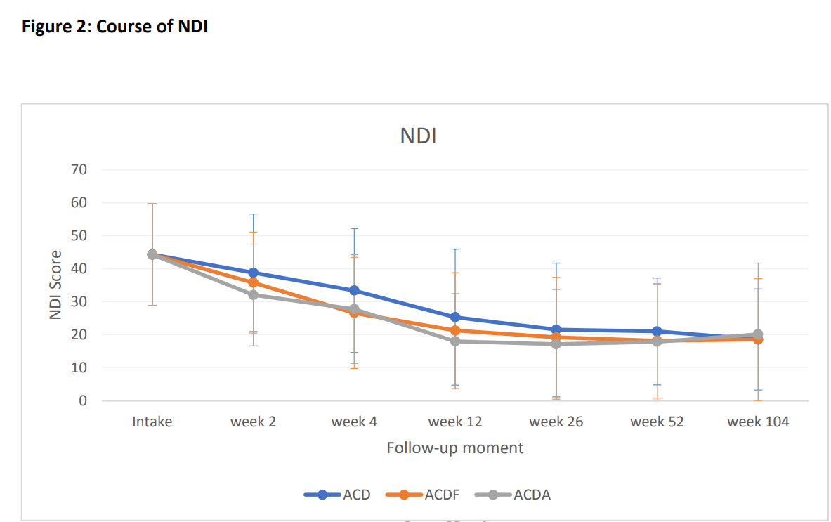
Comperision between ACDA, ACDF AND ACD
ACDF: anterior cervical discectomy and fusion
ACD: anterior cervical discectomy
ACDA: anterior cervical discectomy

Slide 24
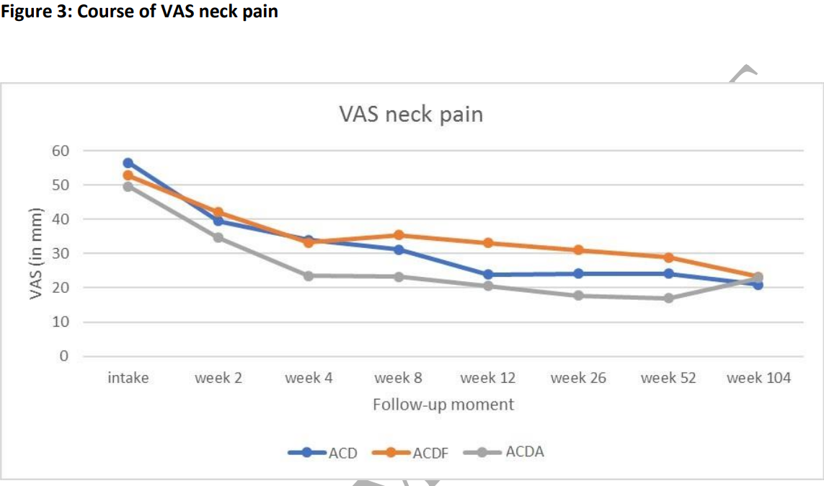
Comperision between ACDA, ACDF AND ACD

Slide 25
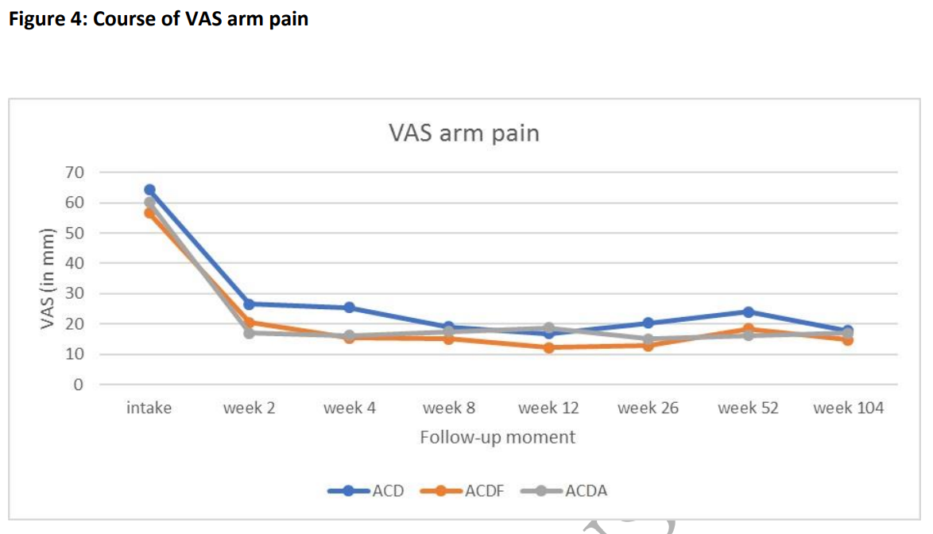
Comperision between ACDA, ACDF AND ACD

Slide 26
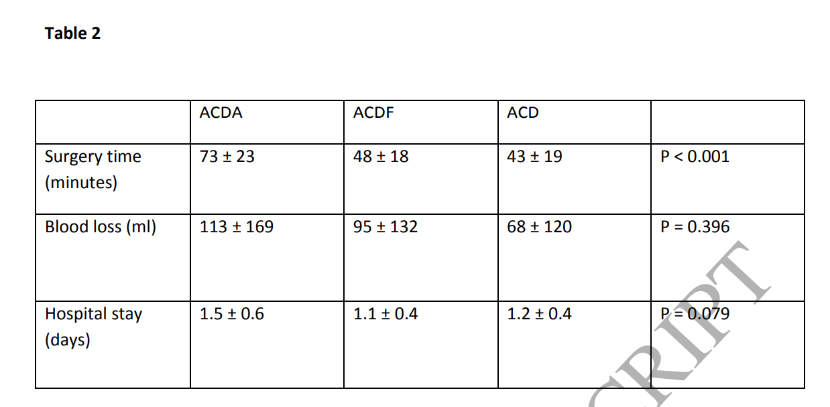
Comperision between ACDA, ACDF AND ACD

Slide 27
Comparison of Outcomes for ACDF with and without Anterior Plate Fixation

Slide 28
CONLUSION
Anterior cervical discectomy and fusion (ACDF) is a type of neck surgery that involves removing a damaged disc to relieve spinal cord or nerve root pressure and alleviate corresponding pain, weakness, numbness, and tingling.
An ACDF is done with an anterior approach, which means that the surgery is done through the front of the neck as opposed to through the back of the neck. This approach has several typical advantages:Direct access to the disc and Less postoperative pain

Slide 29
THANK YOU

