Slide 1
Transanal Total Mesorectal Excision For Mid‑Low Rectal Cancer
THAI NGUYEN UNIVERSITY OF MEDICINE AND PHARMACY
By Dr. Tam Van Nguyen

Slide 2
OVERVIEW

Slide 3
Background
Colorectal cancer (CRC) is the fourth most frequently diagnosed cancer and the second leading cause of cancer death in the United States. In 2022, an estimated 44,850 new cases of rectal cancer will occur in the United States (26,650 cases in males; 18,200 cases in females).
Surgery for rectal cancer based on total mesorectal excision (TME) principles, remains a challenging procedure, irrespective of the surgical approach. The difficulties of anatomic access to the depths of the pelvis affect the surgeon’s ability to achieve a meticulous cancer dissection.

Slide 4
Total mesorectal excision
TME is the gold standard surgical treatment for mid and low rectal cancer; however, it is associated with specific technical hurdles.
Oncological adequacy in rectal cancer surgery mandates not only a clear distal and circumferential resection margin but also resection of the entire ontogenetic mesorectal package. Incomplete removal of the mesentery is one of the commonest causes of local recurrences.

Slide 5
Total mesorectal excision
Although TME significantly improved the oncological and functional results of rectal cancer surgery, the difficulty of the procedure is still mainly dependent on and determined by the dissection of the most distal part of the rectum and mesorectum.
Transanal TME (TaTME) is a new procedure developed to overcome these difculties, through an enhanced visualization of the dissection plane. This potentially could result in a more accurate distal dissection with a lower rate of positive circumferential resection margins, increasing the rate of sphincter-saving procedures.

Slide 6
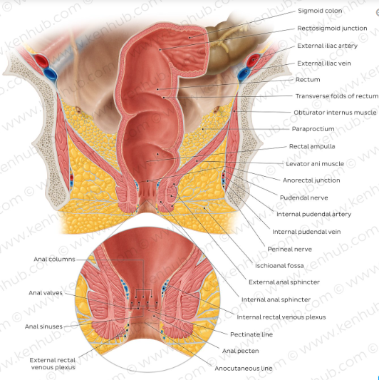
Rectum anatomy
The rectum is about 12cm long, the upper segment is the same diameter as the sigmoid colon (about 4cm when empty), but the lower segment is enlarged, forming ampulla rectum.
The peritoneum covers only two thirds of the rectum (Gray). The peritoneum covers the anterior surface and lowers the sides; Therefore, the line of adhesion around the rectum is deviated in the shape of a U, with horizontal strokes in front and below and 2 vertical strokes on both sides.

Slide 7
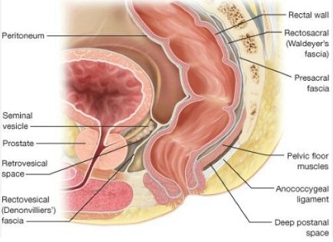
Mesentery of the rectum
Embryologically, the mesentery is formed from a collection of ring-shaped, multilayered mesenchymal cells that make up the outside of the rectum.
The essence of the mesentery is a layer of fatty tissue, blood vessels, lymphatic vessels, lymph nodes, and autonomic nerves that surround and extend the length of the rectum. This mesentery forms a cord layer mainly in the rectum. posterior and lateral to the rectum, has the shape of two waters.
The outermost layer of the mesentery is thickened, forming the outer fascia, also known as the rectal fascia.

Slide 8
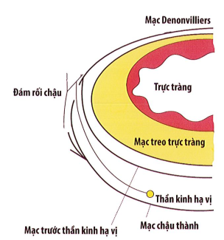
Mesentery of the rectum
The pelvis is divided into two compartments, namely the parietal cavity and the visceral space covered by the parietal fascia and visceral fascia, between these two compartments is loose connective tissue.
Behind the rectum, there is more than one avascular space between the sacrum and the rectum, prehypogastric nerve fascia and the anterior sacral fascia is located in a multilayered structure posterior to the rectum, the anterior scapula appears to be divided into several adherent layers. The anterior hypogastric nerve fascia with the innermost layer of the anterior sacral fascia, running anteriorly and connecting with the Denonvilliers fascia.

Slide 9
Mesentery of the rectum
Conclusion, in the multilayer structure posterior to the rectum, the anterior hypogastric fascia lies between the rectilinear fascia and the anterior sacral fascia. The anterior dissection in front of the hypothalamic nerve when moving the posterior side of the rectum ensures the dissection according to the principle of cancer and preserves the hypothalamic nerve.

Slide 10
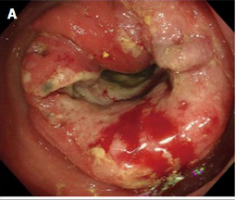
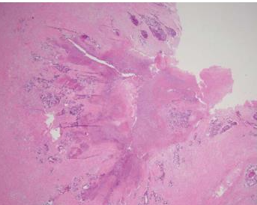
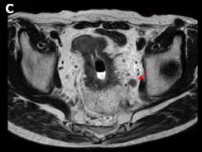
Diagnosis
Pathology
MRI, CT, XQ,…
Colonoscopy

Slide 11
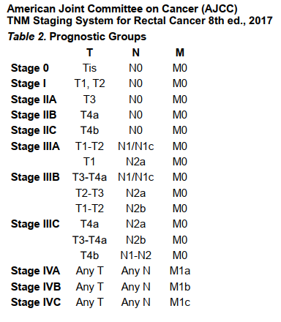
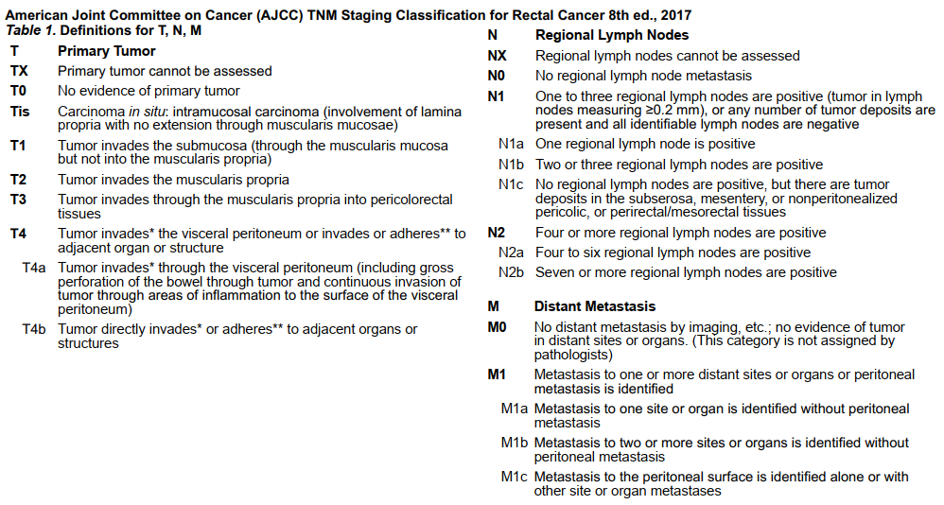
Stage diagnosis

Slide 12
Treatment

Slide 14
SURGICAL

Slide 15
Surgical options
Local excision
Full-thickness resection
Endoscopic submucosal dissection
Sphincter sparing
Partial mesorectal excision
Total mesorectal excision: Larparoscopic TME, Open TME, TaTME, NOTES
Abdominoperineal resection
Laparotomy
Open abdominal surgery: Miles

Slide 16
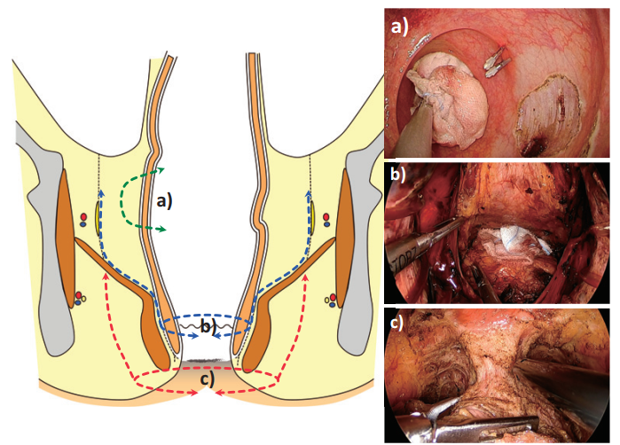
Surgical options
a) Local excision
b) Intersphincteric resection (ISR)
c) Abdominoperineal resection (APR)
Hasegawa S, Yoshida Y, Morimoto M, et al. Transanal TME: new standard or fad? Journal of the Anus, Rectum and Colon. 2019 ;3(1):1-9. DOI: 10.23922/jarc.2018-030. PMID: 31559361; PMCID: PMC6752130.

Slide 17
Transanal Total Mesorectal Excision ( TaTME)

Slide 18
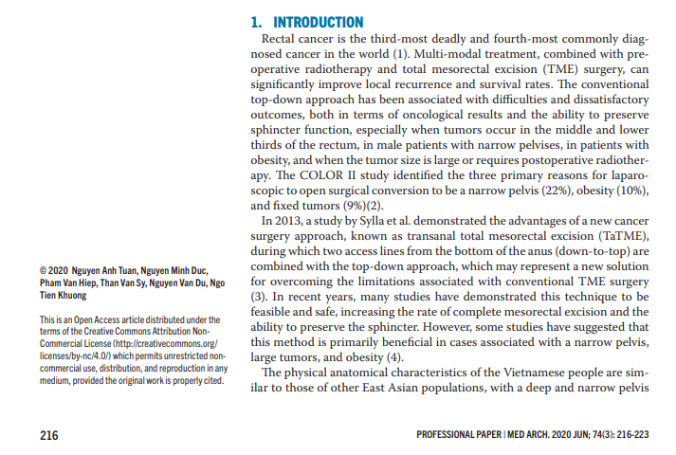
Tuan NA, Duc NM, Van Hiep P, Van Sy T, Van Du N, Khuong NT. The Efficacy of Transanal Total Mesorectal Excision: a Preliminary Vietnamese Report. Med Arch. 2020 Jun;74(3):216-223. doi: 10.5455/medarh.2020.74.216-223. PMID: 32801439; PMCID: PMC7405999.

Slide 19
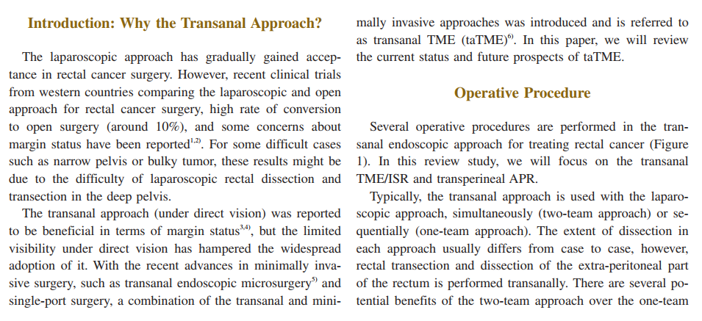
Hasegawa S, Yoshida Y, Morimoto M, et al. Transanal TME: new standard or fad? Journal of the Anus, Rectum and Colon. 2019 ;3(1):1-9. DOI: 10.23922/jarc.2018-030. PMID: 31559361; PMCID: PMC6752130.

Slide 20
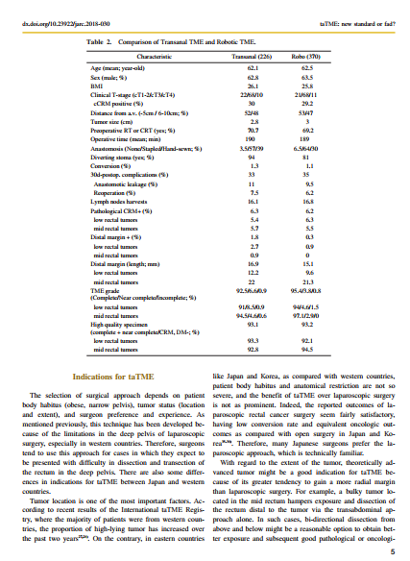
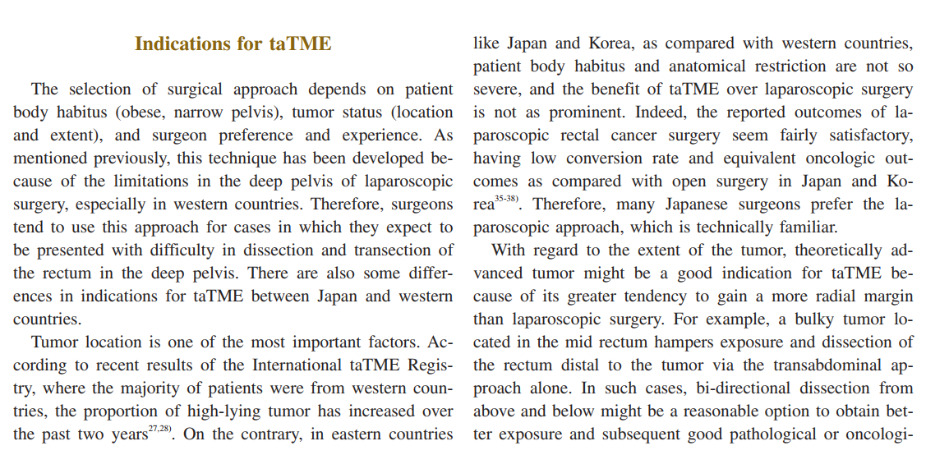
Hasegawa S, Yoshida Y, Morimoto M, et al. Transanal TME: new standard or fad? Journal of the Anus, Rectum and Colon. 2019 ;3(1):1-9. DOI: 10.23922/jarc.2018-030. PMID: 31559361; PMCID: PMC6752130.

Slide 22
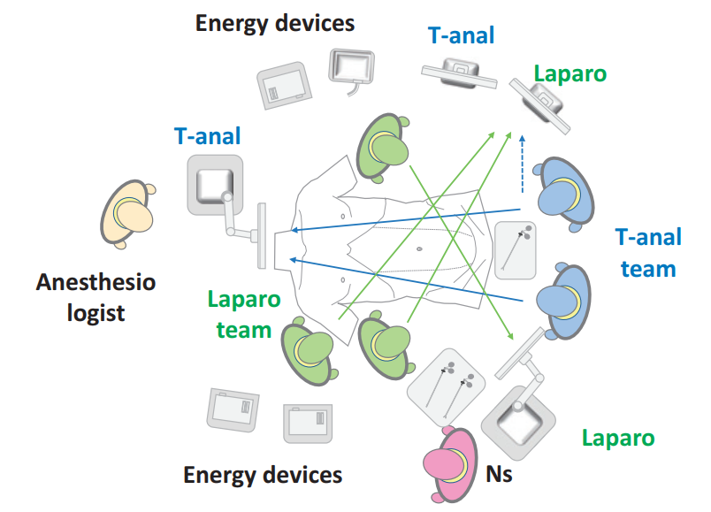
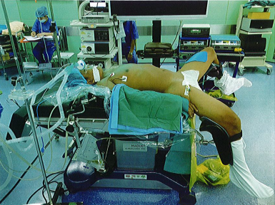
Set up Operative Devices
Patient's position

Slide 23
Main steps
The perineal phase 1: Dissection of the mesentery of the rectum
The abdominal phase: Dissection the sigmoid colon, descending colon and high rectum
The perineal phase 2: Resection of rectum with tumor and creating coloanal anastomosis

Slide 24
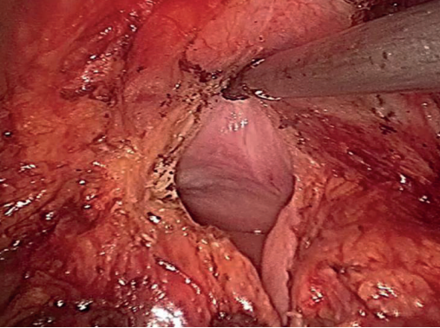
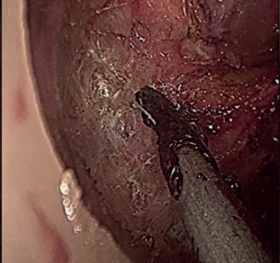
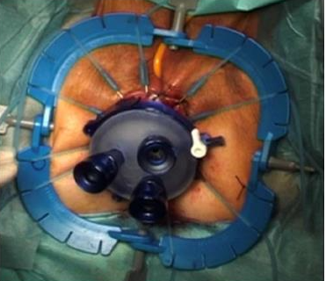
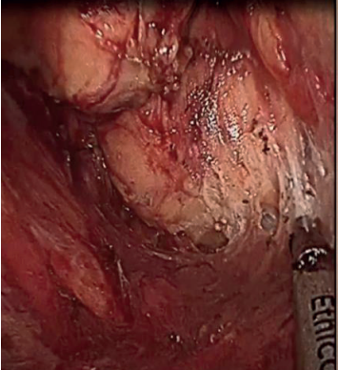
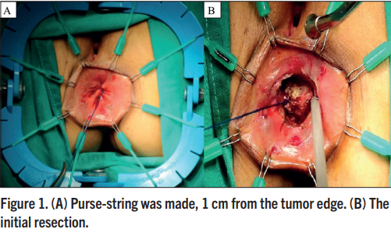
The perineal phase 1
A purse-string around the anus.
Set up a Lone Star Retractor System.
To plane dissection was extended cranially, up between the intersphincteric space, to the level of the puborectal sling.
Dissection in the posterior plane, before being extended to the lateral and anterior aspects until reaching the peritoneal cavity.
Tuan NA, Duc NM, Van Hiep P, Van Sy T, Van Du N, Khuong NT. The Efficacy of Transanal Total Mesorectal Excision: a Preliminary Vietnamese Report. Med Arch. 2020 Jun;74(3):216-223. doi: 10.5455/medarh.2020.74.216-223. PMID: 32801439; PMCID: PMC7405999

Slide 25
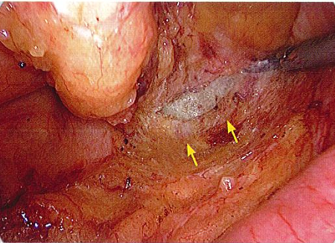
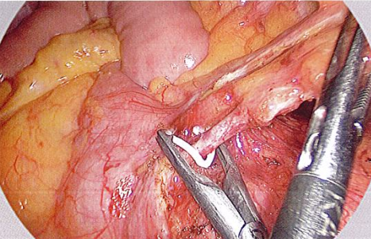
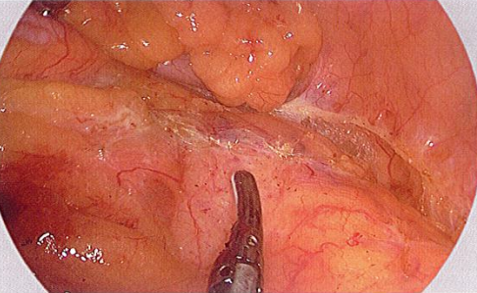
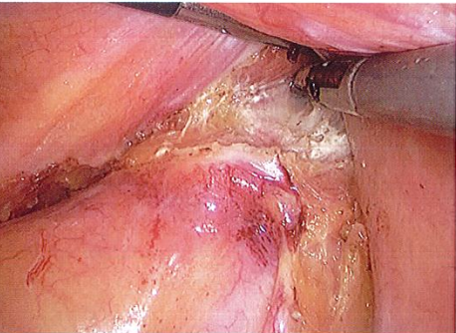
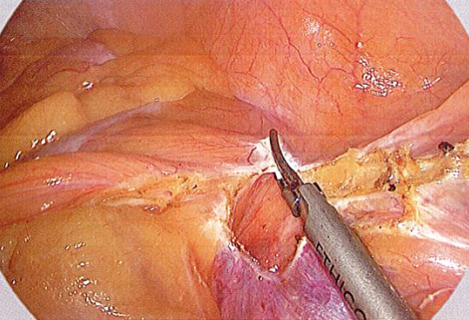
The abdominal phase
Resection the inferior mesenteric artery and vein
Mobilize the left colon and sigmoid colon
TME was performed top-down, along the avascular space, preserving the automatic nerve plexus.
Tuan NA, Duc NM, Van Hiep P, Van Sy T, Van Du N, Khuong NT. The Efficacy of Transanal Total Mesorectal Excision: a Preliminary Vietnamese Report. Med Arch. 2020 Jun;74(3):216-223. doi: 10.5455/medarh.2020.74.216-223. PMID: 32801439; PMCID: PMC7405999

Slide 26
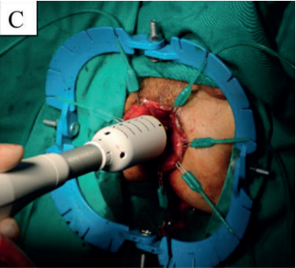
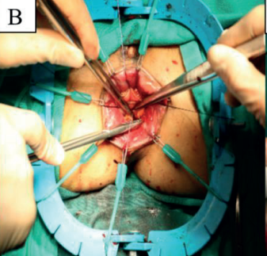
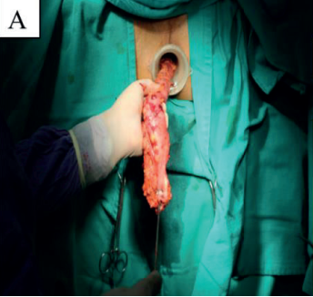
The perineal phase 2
Transanal with drawal of the specimen
Make anastomosis
Tuan NA, Duc NM, Van Hiep P, Van Sy T, Van Du N, Khuong NT. The Efficacy of Transanal Total Mesorectal Excision: a Preliminary Vietnamese Report. Med Arch. 2020 Jun;74(3):216-223. doi: 10.5455/medarh.2020.74.216-223. PMID: 32801439; PMCID: PMC7405999

Slide 27
RESULT

Slide 28
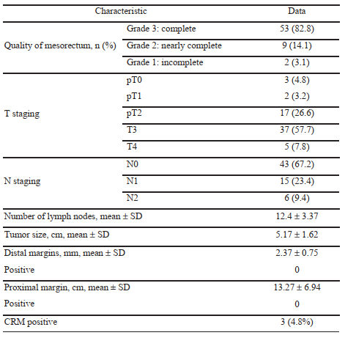
Perioperative data in patients undergoing transanal total mesorectal excision
Tuan NA, Duc NM, Van Hiep P, Van Sy T, Van Du N, Khuong NT. The Efficacy of Transanal Total Mesorectal Excision: a Preliminary Vietnamese Report. Med Arch. 2020 Jun;74(3):216-223. doi: 10.5455/medarh.2020.74.216-223. PMID: 32801439; PMCID: PMC7405999

Slide 29
Compare LAR TME with TaTME
Filips A, Haltmeier T, Kohler A, Candinas D, Brügger L, Studer P. LARS is Associated with Lower Anastomoses, but not with the Transanal Approach in Patients Undergoing Rectal Cancer Resection. World J Surg. 2021 Mar;45(3):873-879. doi: 10.1007/s00268-020-05876-6. Epub 2020 Dec 10. PMID: 33301048; PMCID: PMC7851016.

Slide 30
Low Anterior Resection Syndrome Score – LARS score

Slide 31
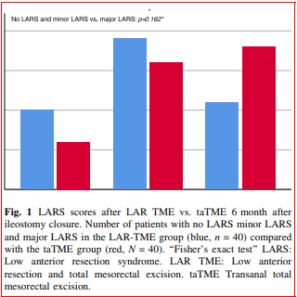
A detailed analysis showed that the incidences of minor and major LARS were not different between the TaTME and LAR-TME groups (Fig. 1)
Filips A, Haltmeier T, Kohler A, Candinas D, Brügger L, Studer P. LARS is Associated with Lower Anastomoses, but not with the Transanal Approach in Patients Undergoing Rectal Cancer Resection. World J Surg. 2021 Mar;45(3):873-879. doi: 10.1007/s00268-020-05876-6. Epub 2020 Dec 10. PMID: 33301048; PMCID: PMC7851016.

Slide 32
Disease-Free Survival After Transanal Total Mesorectal Excision: Results From the International TaTME Registry
The 5-year cumulative DFS (74.1% vs 60%, p = 0.18) and OS (85.9% vs 70%, p = 0.10) rates tended to be higher in patients with complete than incomplete-TILME of Jin Cheon Kim 2021.

Slide 33
CONCLUSION
Rectal cancer is a very common type of cancer
Early diagnosis and treatment of rectal cancer increases survival rates and life quality
TME is the gold standard surgical treatment for mid and low rectal cancer
TaTME might have several benefits over laparoscopic surgery, especially for cases in which dissection and transection of the rectum is expected to be difficult especially for low rectal cancer.
TaTME is still a technically difficult, complex procedure that remains a challenge for developing medical systems in terms of process synergies.
It is most important to do good surgery, based on the principles of surgical oncology, regardless of surgical approach. .

