Slide 1
intertrochanteric fracture
THAI NGUYEN UNIVERSITY OF MEDICINE AND PHARMACY
Dr. nguyen ngoc son

Slide 2
Overview
Intertrochanteric Fractures are common extracapsular fractures of the proximal femur at the level of the greater and lesser trochanter that are most commonly seen following ground-level falls in the elderly population.
Diagnosis is made with orthogonal radiographs of the hip. MRI is most helpful to evaluate occult hip fractures.
Treatment is generally operative with sliding hip screw versus cephalomedullary nail depending on fracture stability.

Slide 3
Overview
Incidence:
Account for ~50% of hip fractures
150,000 intertrochanteric fractures per year in US
500 per 100,000 population per year for elderly female
200 per 100,000 population per year for elderly male

Slide 4
ANATOMY
“Intertrochanteric” means “between the trochanters,” which are bony protrusions on the femur (thighbone). They're the points where the muscles of the thigh and hip attach. There are two trochanters in the body: the greater trochanter and the lesser trochanter.
Intertrochanteric fractures are breaks of the femur between the greater and the lesser trochanters and Subtrochanreric

Slide 5
Symptoms
The most common symptoms of intertrochanteric fractures include:
Severe pain in the hip
Not being able to put weight on the injured side’s leg
Not being able to move or stand up after a fall
Bruising and swelling around the hip
Stiffness and pain in the leg of the injured side
Having a leg in an unnatural position or turned to the injured side

Slide 6
The risk factors for intertrochanteric fractures include:
Being female
Being older than 60
Having a history of falls
Having osteoporosis
Having a history of other bone problems or fractures
Having low bone density and low muscle mass
Having problems with walking or balance

Slide 7
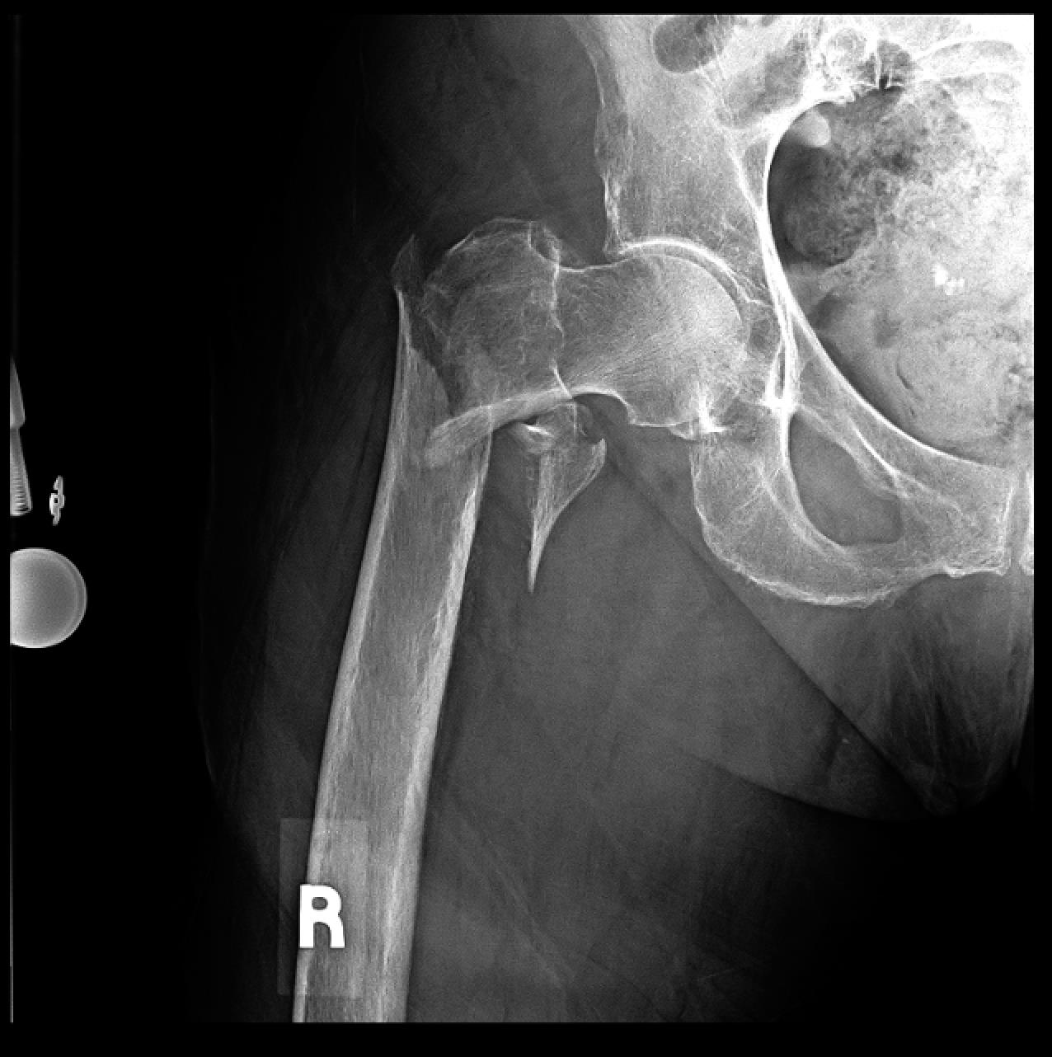
diagnose
Most cases are diagnosed by x-ray and physical exam and medical history
In addition, MRI and bone scan is also diagnostic tools
Notes:
will ask about your medical history and do a physical exam. Then, they’ll likely order X-rays or other imaging tests to diagnose an intertrochanteric fracture
Usually, X-rays provide enough information for your doctor to diagnose a hip fracture. However, small hairline fractures may not show up on X-rays, so other imaging tests may be necessary

Slide 8
CLASSIFICATION
Boyd and Griffin initially described four types of pertrochanteric femoral fractures in 1949 (Fig.55.24):
Type 1: Fractures that extend along the intertrochanteric line
Type 2: Comminuted fractures with the main fracture line along the intertrochanteric line but with multiple secondary fracture lines (may include coronal fracture line seen on lateral view)
Type 3: Fractures that extend to or are distal to the lesser trochanter
Type 4: Fractures of the trochanteric region and proximal shaft with fractures in at least two planes

Slide 9
CLASSIFICATION
AO/OTA classification (Fig.55.25):
A1: Fractures are not comminuted (single fracture line extending medially).
A2: Fractures have increasing comminution (separate lesser trochanteric fragment).
A3: Fractures include reverse obliquity, transverse, or subtrochanteric extension patterns.

Slide 10
Treatment options
The most common treatment for intertrochanteric fractures is surgery. In most cases, surgery is recommended because this fracture can take a long time to heal on its own. One of the most common surgical treatments for this type of hip fracture is an open reduction and internal fixation (ORIF). This is a type of surgery that puts the broken bone in place and fixes it with screws, rods, pins, or plates.
However, surgery may not be an option if you have bleeding problems or can’t tolerate anesthesia.

Slide 11
surgery
Locking plate, vis
Dynamic hip screw (DHS)
Proximal femoral nail (PFN)
Bipolar hemiarthroplasty (BHA)

Slide 12
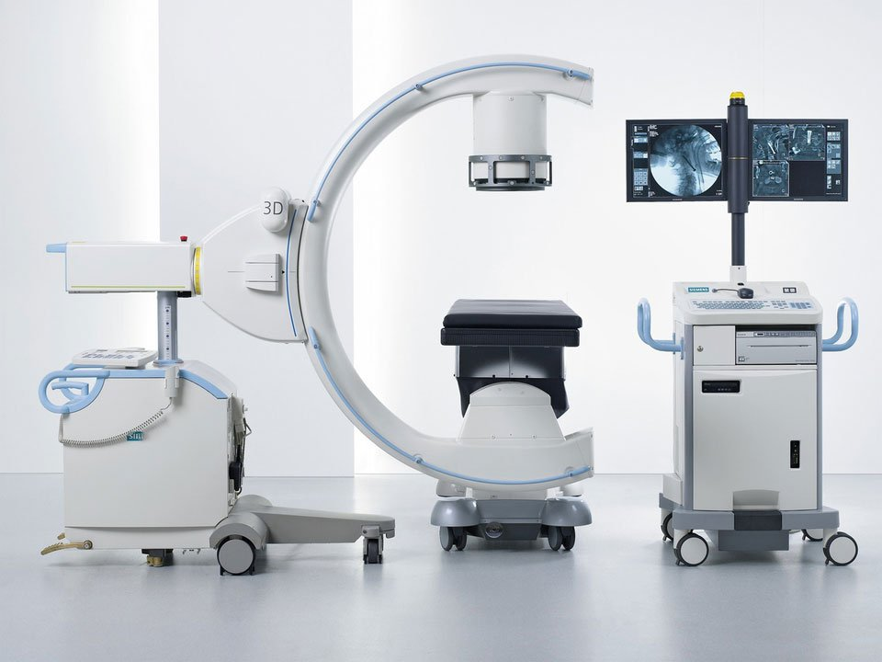
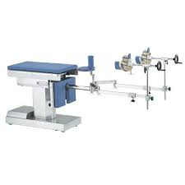

Slide 13
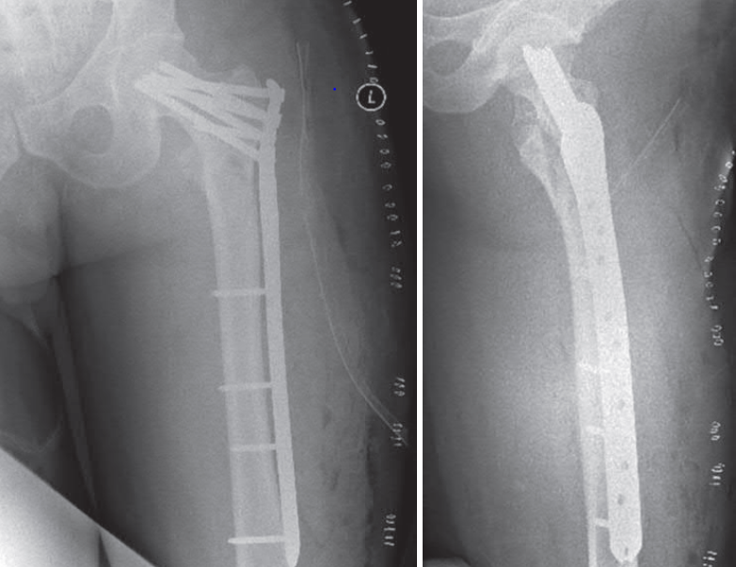
locking plate, vis

Slide 15
dynamic hip screw (DHS)

Slide 18
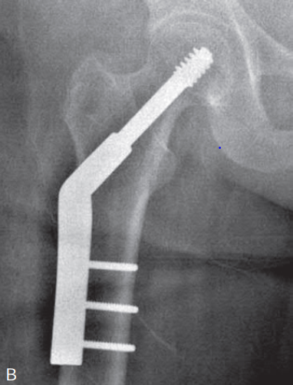
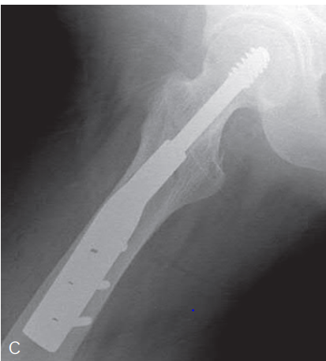

Slide 19
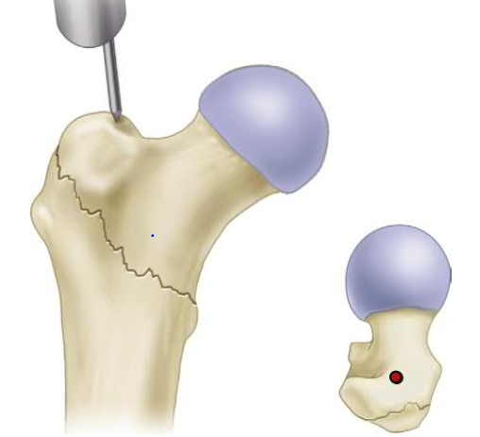
proximal femoral nail (PFN)

Slide 21
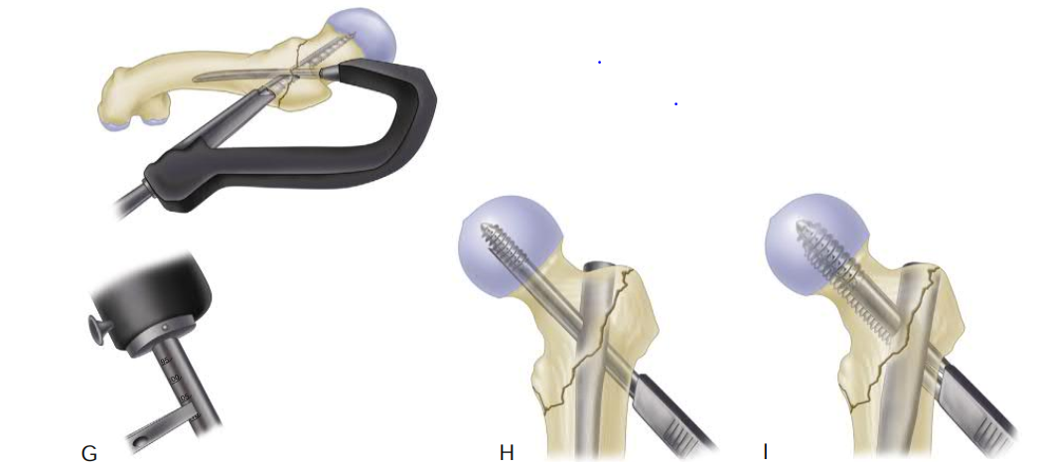

Slide 23
bipolar hemiarthroplasty (BHA)

Slide 26
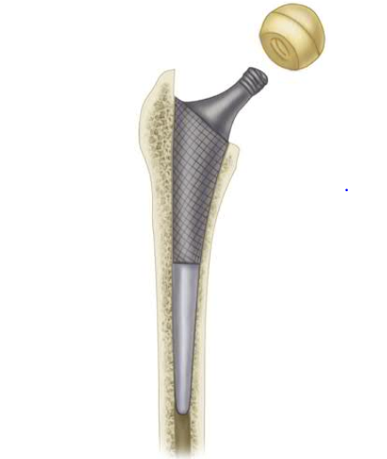

Slide 27
Results (The effectiveness of primary bipolar arthroplasty in treatment of unstable intertrochanteric fractures in elderly patients , North American Journal of Medical Sciences 2010 December )

Slide 30
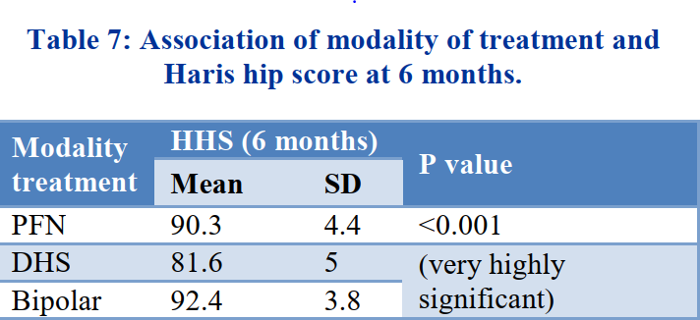
Management of complex intertrochanteric fractures of the femur in elderly patients – dynamic hip screws or proximal femoral nails or arthroplasty (International Journal of Research in Orthopaedics Hussain N et al. Int J Res Orthop. 2017 Jul;3(4):656-660 http://www.ijoro.org )
The PFN group and bipolar group in our study performed much better in view of union rates, complications, blood transfusion and functional outcome based on HHS than the DHS group

Slide 31
Fracture fixation versus hemiarthroplasty for unstable intertrochanteric fractures in elderly patients: A systematic review and network meta-analysis of randomized controlled trials (Orthopaedics & Traumatology: Surgery & Research j o ur nal homepa ge: www.elsevier.com 2021)
Conclusion
We found that, in terms of the unstable ITF model, studies suggest that BHA may be the best performing strategy in terms of reducing the risk of surgical failure, reoperation, and HHS by comparison. with PFN and DHS for 6 months after operation.

Slide 32
THANK YOU

