Slide 1
Update Diagnostic criteria, severity grading and treatment of acute cholecystitis

Slide 2
Background
Acute calculous cholecystitis is a common digestive disease. However, the treatment of acute calculous cholecystitis has many different perspectives.
The Tokyo Guidelines 2018 (TG18) diagnostic criteria and severity grading of acute cholecystitis, have become widely adopted in recent years, being used not only in clinical practice but also in numerous research studies on this disease

Slide 3
1. Diagnostic criteria
A. Local signs of inflammation etc.
(1) Murphy's sign, (2) RUQ mass/pain/tenderness
B. Systemic signs of inflammation etc.
(1) Fever, (2) elevated CRP, (3) elevated WBC count
C. Imaging findings
Imaging findings characteristic of acute cholecystitis
Suspected diagnosis: one item in A + one item in B
Definite diagnosis: one item in A + one item in B + C

Slide 4
2. severity grading
Grade III (severe) acute cholecystitis
“Grade III” acute cholecystitis is associated with dysfunction of any one of the following organs/systems:
1. Cardiovascular dysfunction: hypotension requiring treatment with dopamine ≥5 μg/kg per min, or any dose of norepinephrine
2. Neurological dysfunction: decreased level of consciousness
3. Respiratory dysfunction: PaO₂/FiO₂ ratio <300
4. Renal dysfunction: oliguria, creatinine >2.0 mg/dl
5. Hepatic dysfunction: PT-INR >1.5
6. Hematological dysfunction: platelet count <100,000/mm³

Slide 5
2. severity grading
Grade II (moderate) acute cholecystitis
“Grade II” acute cholecystitis is associated with any one of the following conditions:
1. Elevated WBC count (>18,000/mm³)
2. Palpable tender mass in the right upper abdominal quadrant
3. Duration of complaints >72 hª
4. Marked local inflammation (gangrenous cholecystitis, pericholecystic abscess, hepatic abscess, biliary peritonitis, emphysematous cholecystitis)
Grade I (mild) acute cholecystitis
“Grade I” acute cholecystitis does not meet the criteria of “Grade III” or “Grade II” acute cholecystitis. It can also be defined as acute cholecystitis in a healthy patient with no organ dysfunction and mild inflammatory changes in the gallbladder, making cholecystectomy a safe and low-risk operative procedure

Slide 6
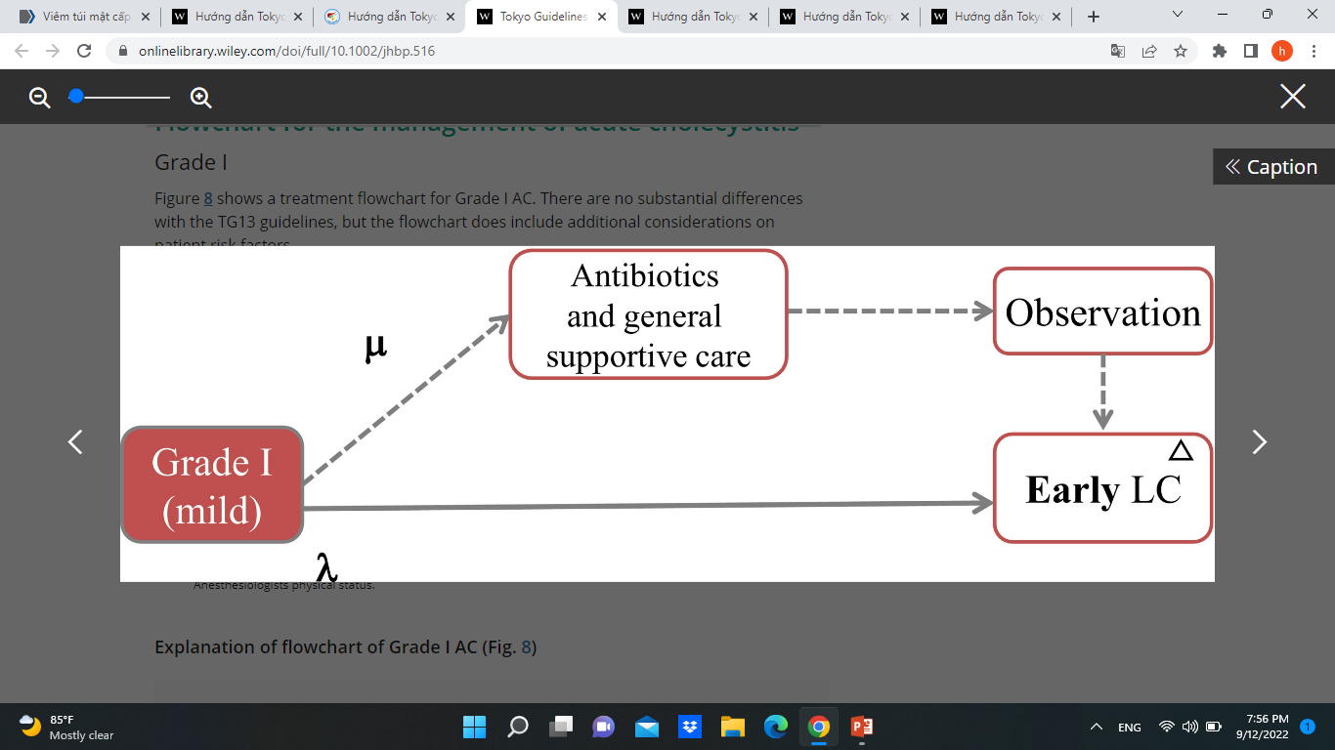
3. treatment
Grade I
Notes:
Grade I. λ, CCI 5 or less and/or ASA class II or less (low risk); µ, CCI 6 or greater and/or ASA class III or greater (not low risk); ▵, in case of serious operative difficulty, bail-out procedures including conversion should be used. ASA-PS American Society of Anesthesiologists physical status

Slide 7
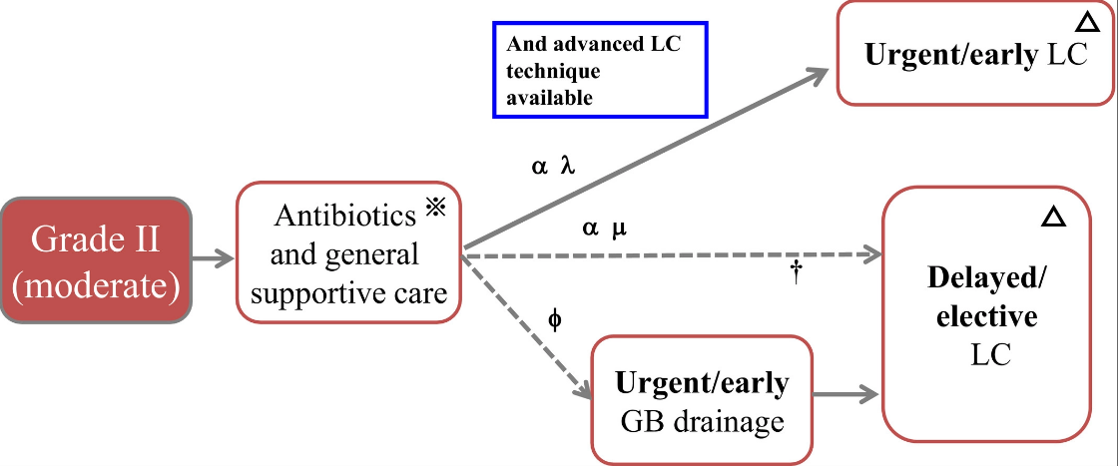
3. treatment
Grade II
Notes:
Grade II. α, antibiotics and general supportive care successful; ϕ, antibiotics and general supportive care fail to control inflammation; λ, CCI 5 or less and/or ASA-PS class II or less (low risk); µ, CCI 6 or greater and/or ASA-PS class III or greater (not low risk); ※, performance of a blood culture should be taken into consideration before initiation of administration of antibiotics; †, a bile culture should be performed during GB drainage; ▵, in case of serious operative difficulty, bail-out procedures including conversion should be used. ASA-PS American Society of Anesthesiologists physical status, CCI Charlson comorbidity index, GB gallbladder, LC laparoscopic cholecystectomy

Slide 8
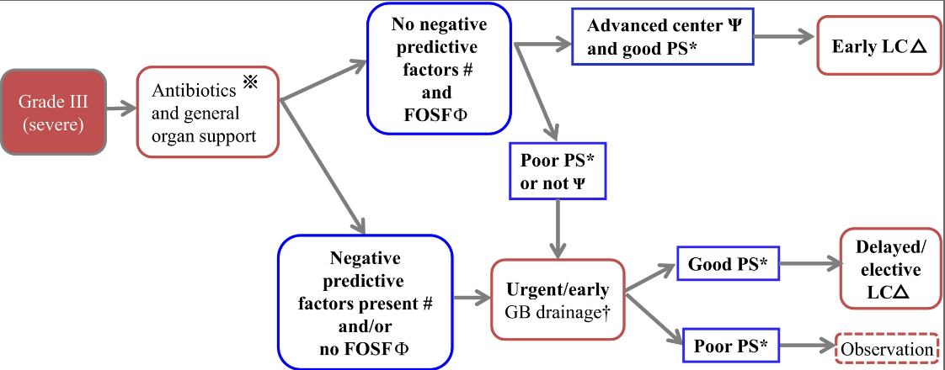
3. treatment
Grade III
Notes:
Grade III. ※, performance of a blood culture should be taken into consideration before initiation of administration of antibiotics; #, negative predictive factors: jaundice (TBil ≥2), neurological dysfunction, respiratory dysfunction; Φ, FOSF: favorable organ system failure = cardiovascular or renal organ system failure which is rapidly reversible after admission and before early LC in AC; *, in cases of Grade III, CCI (Charlson comorbidity index) 4 or greater, ASA-PS 3 or greater are high risk; †, a bile culture should be performed during GB drainage; Ψ, advanced center = intensive care and advanced laparoscopic techniques are available; ▵, in case of serious operative difficulty, bail-out procedures including conversion should be used. GB gallbladder, LC laparoscopic cholecystectomy, PS performance status

Slide 9
3.1. gallbladder drainage
Optimal timing of gallbladder drainage
For patients with moderate (grade II) disease, gallbladder drainage should be used only when a patient does not respond to conservative treatment.
For patients with severe (grade III) disease, gallbladder drainage is recommended with intensive care.
Predictors for failure of conservative treatment:
Age above 70 years old, diabetes, tachycardia and a distended gallbladder at admission.
WBC >15000 cell/μl, an elevated temperature and age above 70 years old were found to be predictors for the failure of conservative treatment at 24-h and 48-h follow-up.

Slide 10
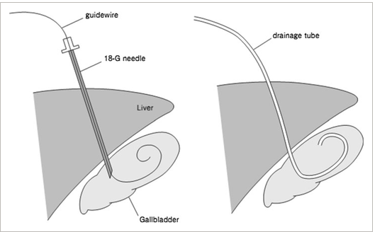
3.1.1.Percutaneous transhepatic gallbladder drainage
After ultrasound-guided transhepatic gallbladder puncture has been performed with an 18-G needle, a 6- to 10-Fr catheter is placed in the gallbladder using a guidewire under fluoroscopy.

Slide 11
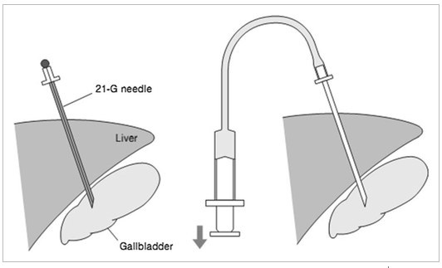
3.1.2.Percutaneous transhepatic gallbladder aspiration
PTGBA: aspiration could be unsuccessful because of replacement of bile with dense biliary sludge or pus

Slide 12
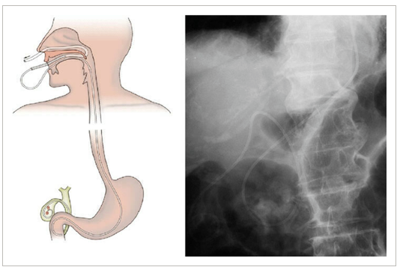
3.1.3. endoscopic naso-gallbladder drainage (ENGBD)
The detailed techniques for ENGBD are as follows: After successful bile duct cannulation, a 0.025- or 0.035-inch guidewire is advanced into the cystic duct and subsequently into the gallbladder. Next, the catheter is withdrawn and the guidewire remains in the gallbladder, and a 5-Fr to 8.5-Fr pigtail NGBT is inserted into the gallbladder.

Slide 13
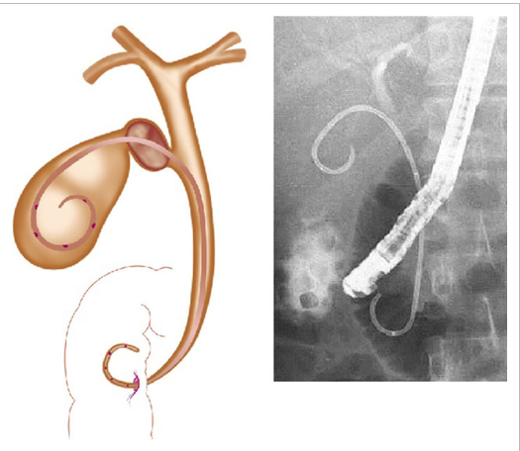
3.1.4. gallbladder stenting (EGBS)
In comparison, the EGBS procedure is the same as for ENGBD, but a 6-Fr to 10-Fr internal stent is placed in the gallbladder, instead

Slide 14
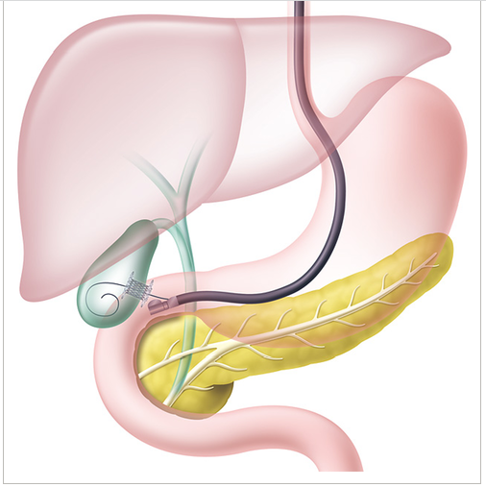
3.1.5. endoscopic ultrasound-guided gallbladder drainage (EUS-GBD)
The gallbladder is punctured from the body or antrum of the stomach or duodenal bulb under direct EUS visualization. A 0.035-inch guidewire is inserted through the outer sheath, and dilation of the tract using a mechanical dilator, electrocautery dilator, or balloon dilator is then performed. Finally, a NGBT, double pigtail plastic stent (PS), or self-expandable metal stent (SEMS) is inserted into the gallbladder

Slide 15
Drainage methoda | Factors that affect the strength of a recommendation
 | Quality of evidence | The balance between desirable and undesirable effects | Technical difficulty | Patient values and preferences | Cost
PTGBD | B (moderate) | Very good | No | Yes | Low cost
PTGBA | C (low) | Good (insufficient drainage effect) | No | No | Very low cost
ENGBD/EGBS | C (low) | Good (low success rate) | Yes (difficult) | Yes/no | Low cost
Surgical cholecystostomy | C (low) | Good (surgical risk) | No | Yes | High cost

Slide 16
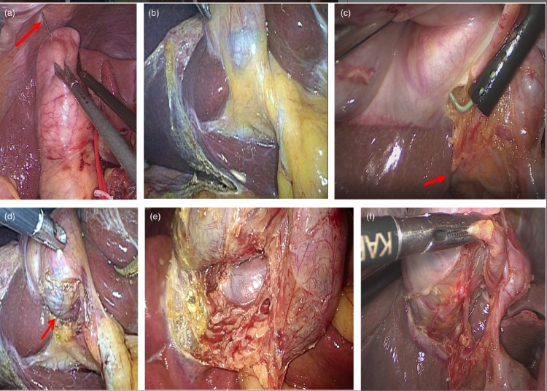
3.2 Surgery laparoscopic cholecystectomy
Step 1: If a distended GB interferes with the field of view, it should be decompressed by needle aspiration
Step 2: Effective retraction of the GB to develop a plane in the Calot's triangle area and identify its boundaries (countertraction)
Step 3: Starting dissection from the posterior leaf of the peritoneum covering the neck of the GB and exposing the GB surface above Rouvière's sulcus
Step 4: Maintaining the plane of dissection on the GB surface throughout LC
Step 5: Dissecting the lower part of the GB bed (at least one-third) to obtain the critical view of safety
Step 6: Creating the critical view of safety
Notes:
bile duct injury (BDI)

Slide 17
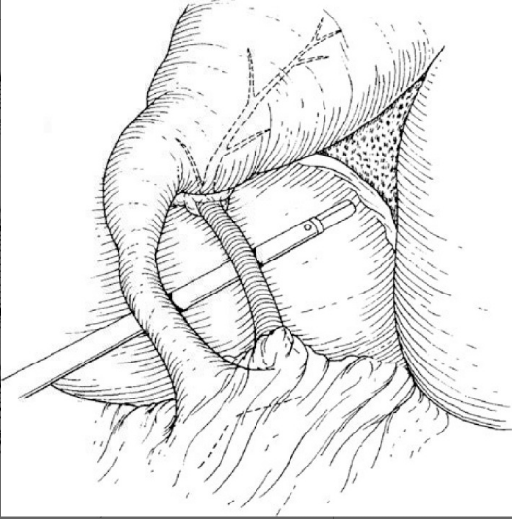
Critical view of safety:
Calot's triangle is dissected free of fat and fibrous tissue and the lower end of the gallbladder is dissected off the liver bed
Failure to create this view is an indication for conversion to Open cholecystectomy

Slide 18


