Slide 1
TOPIC ANTERIOR CRUCIATE LIGAMENT RECONSTRUCTION
Thai Nguyen University Of Medicine And Pharmacy
Name: HA XUAN HUONG
CLASS: Resident Doctor K14

Slide 2
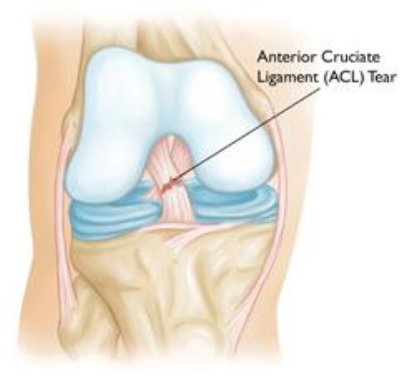
Overview
An anterior cruciate ligament injury is the over-stretching or tearing of the anterior cruciate ligament (ACL) in the knee. A tear may be partial or complete.
In general, the incidence of ACL injury is higher in people who participate in high-risk sports, such as basketball, football, skiing, and soccer.
In the US, ACL injuries total between 100 000 and 200 000 yearly, making this the most common ligament injury.

Slide 3
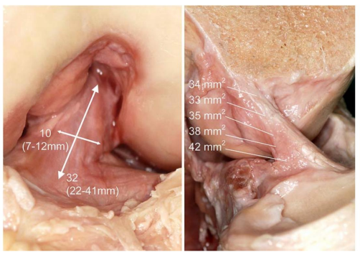
Anterior cruciate ligament
The anterior cruciate ligament is a band of dense connective tissue which courses from the femur to the tibia.
ACL into two parts, the anteromedial bundle (AMB) and the posterolateral bundle (PLB).
The ACL is composed of type I collagen fibers.
the ACL in the femoral intercondylar notch. The mean length is 32 mm (range, 22–41 mm) and the mean width is 10 mm (range, 7–12 mm).

Slide 4
Diagnosis Anterior Cruciate Ligament (ACL) Injuries
Exploit the history of trauma, time, degree of influence on movement, assess function according to Lyshome Gilquist scale.
Symptoms
Signs and symptoms of an ACL injury usually include:
A loud pop or a "popping" sensation in the knee
Severe pain and inability to continue activity
Rapid swelling
Loss of range of motion
A feeling of instability or "giving way" with weight bearing
Clinical examination: Assess the condition of the knee joint by clinical examination methods such as: Lachman, anterior drawer, pivot shift test.

Slide 5
Lachman test
Technique:
Lie the patient supine on the bed. Place the patient's knee in about 20-30 degrees flexion. According to Bates' Guide to Physical Examination, the leg should also be externally rotated slightly. The examiner should place one hand behind the tibia and the other on the patient's thigh. It is important that the examiner's thumb be on the tibial tuberosity. On pulling the tibia anteriorly, an intact ACL should prevent forward translational movement of the tibia on the femur.
Anterior translation of the tibia associated with a soft or a mushy end-feel indicates a positive test. More than about 2mm of anterior translation compared to the uninvolved knee suggests a torn ACL, as does 10mm of total anterior translation. An instrument called a "KT-1000" can be used to determine the magnitude of movement in millimeters.

Slide 6
Anterior Drawer Test
Technique:
The patient lies supine on a plinth with their hips flexed to 45 degrees, his/her knees flexed to 90 degrees, and feet flat on the plinth. The examiner sits on the toes of the tested extremity to help stabilize it. The examiner grasps the proximal lower leg, just below the tibial plateau or tibiofemoral joint line, and attempts to translate the lower leg anteriorly.
The test is considered positive if there is a lack of end feel or excessive anterior translation relative to the contralateral side. Theoretically, the anterior translation if less than 6mm. If it is more than 6mm, the test is considered positive.

Slide 7
Pivot Shift Test
Technique:
The patient lies supine with legs relaxed. The examiner grasps the heel of the involved leg with examiners opposite hand placed laterally on the proximal tibia just distal to the knee. The examiner then applies a valgus stress and an axial load while internally rotating the tibia as the knee is moved into flexion from a fully extended position.
A positive test is indicated by subluxation of the tibia while the femur rotates externally followed by a reduction of the tibia at 30-40 degrees of flexion.

Slide 8
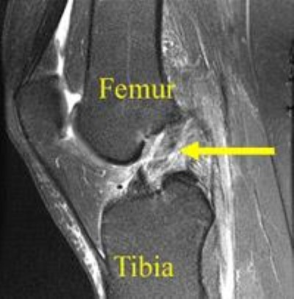
MRI
Evaluation of images of ACL lesions, meniscus, articular cartilage damage, knee anatomical structure,…
Complete rupture of the anterior cruciate ligament is characterized by complete discontinuity of the ligament's fibers and increased signal in its path.

Slide 9
Indications & Contraindicated for anterior cruciate ligament reconstruction
Indications
A simple anterior cruciate ligament rupture causes knee instability
Ligament rupture with other associated injuries of the knee joint (multi-ligament, meniscus)
Contraindicated
ACL reconstruction is contraindicated in patients with partial tears, minimal instability and no joint laxity on examination.
It is also contraindicated in elderly, low-demand patients with minimal instability, patients with knee malalignment and associated comorbidities that make surgical intervention unsafe.

Slide 10
Methods by way of bone tunneling (inside out, outside in, all inside,..)
All-Inside ACL Reconstruction
All inside is a recently developed technique that tunnels the femur and tibia from the inside out. Both of these tunnels only go through a part of the bone, that is, a "truncated" tunnel.
Performing this technique requires a special tool to tunnel the tibial plateau from the inside of the joint to the outside. This tool has several types such as: Arthrex's Flipcutter.
In 2016, Octav Russu reported the results of All-Inside ACL reconstruction surgery in 27 patients. Achieving good results in all patients, the average Lysholm score after surgery was 95.55 ± 4.63
In 2015 at Viet Duc Hospital, author Nguyen Manh Khanh reported the initial results of endoscopic reconstruction of ACL by the "All inside" method with 84 patients with good and very good results of 100%.

Slide 11
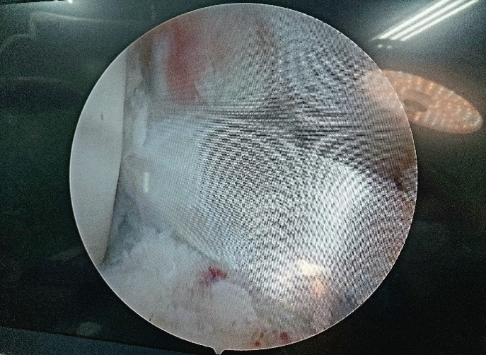
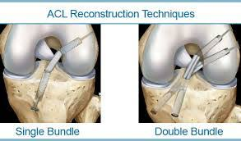
Methods according to the anatomical structure of the ACL
Single-bundle anterior cruciate ligament reconstruction
The principle of the technique is to create the attachment site of the new ligament that is the closest approximation to the anatomical position of the original ACL while at the same time creating an isometric interval between the two locations of the tunnel.
ACL reconstruction with only a single bundle, gives good results with rates of 80%-98% and is the most popular method today.
In 2018, Tran Quoc Lam reported reconstruction of the ACL with single-bundle technique, Lysholm score at 6 months after surgery was: 93.9±4.7 points,

Slide 12
Double-bundle Anterior Cruciate Ligament reconstruction
The principle of 2-bundle ligament reconstruction is an anatomical principle based on the anatomical structure of the ACL
Le Thanh Hung (2014) reported the results of two-bundle ACL reconstruction with an average Lysholm score of 90.33 points, good and very good rates of 94.9%.
Lam Thanh Hai(2020) reported the results of two-bundle ACL reconstruction with an average Lysholm score of 93,69±3,6
Hybrid anterior cruciate ligament reconstruction

Slide 13
Techniques according to the source of grafts using reconstruction of the ACL
Autograft
Advantages: Autograft provides bone cells (osteogenic cell) and growth factors that are essential for healing and bone regeneration. No risk of disease transfer. There is no risk of rejection of the autograft.
Disadvantages: Need of second surgical procedure. Limited availability. Donor site pain. Procurement morbidity. Everyone is not having bone which is suitable for autograft
Ngo Van Toan evaluated the results in 7 years of surgery to reconstruct the anterior cruciate ligament for 865 patients with rupture of the anterior cruciate ligament with autologous tapered and semi-tendon tendons, the longest follow-up time was 2 years. good and very good rate reached 92.25%

Slide 14
Allograft
Advantages of using allograft tissue include elimination of pain caused by obtaining the graft from the patient, decreased surgery time and smaller incisions.
Disadvantages: including viral transmission (HIV and Hepatitis C), infection from allograft tissue
In 2018, Tran Hoang Tung presented the results of a study of 36 cases of ACL lesions reconstructed using the allograft by two-bundle technique, the good rate after surgery reached 94.5%.

Slide 15
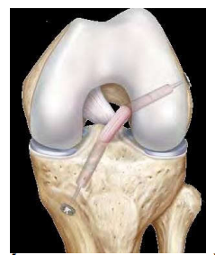
Techniques in the way of fixing the puzzle piece
Secure the puzzle piece with vertical dowel screws
Secure the puzzle piece with the horizontal dowel screw.
Endo button-style latch screw
“All-inside”: Retroscrew and TightRope

Slide 16
THANKS FOR WATHCHING

